Slide 1












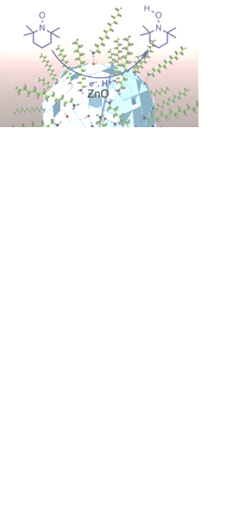
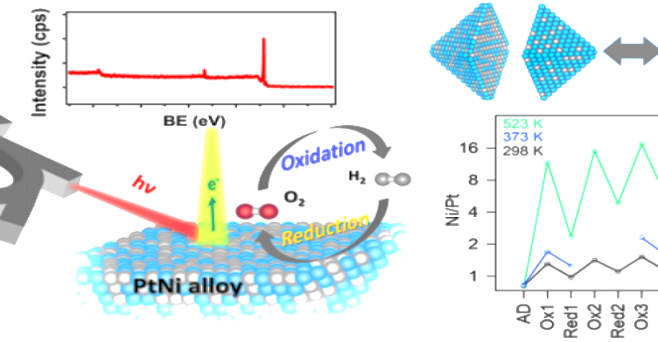

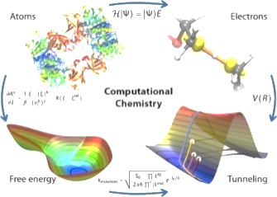
People's Democratic Republic of Algeria
Ministry of Higher Education and Scientific Research
In collaboration with : Department of Chemistry and
Laboratory of Materials Chemistry, Catalysis and Reactivity
The first International Conference on Chemistry Science, Materials Design and their applications ICCSM’2024
November 18-20, 2024 -Chlef-
Conference objectives
Online submission
Chemistry stands as an experimental science dedicated to serving humanity, positioned at the crossroads of numerous disciplines including biology, pharmacology, health sciences, materials science, pharmacy, environmental studies, electronics, agronomy, and more. The objective of this event is to convene experts from diverse realms of chemistry alongside post-graduate scholars, facilitating the presentation and discussion of their research findings, fostering the exchange of experiences, and collectively assessing the landscape of research across the key branches of chemistry. Additionally, it aims to shed light on the challenges encountered by researchers since the inception of chemistry research laboratories in Algeria.
Advise and guide the work of PhD student.
Establishment and development of sustainable.
Thematic research links and networks Publication of the scientific work of the congress and future publications on the treated issues in impacted journals.
Conference registration and abstract submission must be done online only via :
,,,,,,,,,,,,,,,,,,,,,,,,,,,,,,,,,,,,,,,,,,,,,,,,,,,,,,,,,,,,,,,
TOPICS
Publication
The proceedings of the conference abstracts will be published online by …..
Publisher with unique ISBN and DOI at book level,
Indexation :
4-Chemistry for Sustainability
2- Environmental and Green Chemistry
6-Organic Chemistry
1-Materials chemistry and functional
Materials
5-Applied Chemistry
and Catalysis
7- Theoretical and
Computationnel Chemistry
3-Nano Chemistry

Slide 2


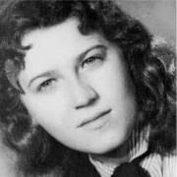
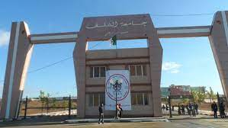

Honorary Commitee
Scientific Commitee
Registration fees
without accomodation
Pr. D. ACHOUR
Rector of University Hassiba Ben Bouali Chlef.
Pr. M. TAHAR ABBES M
Dean of Exact Sciences and Informatics Faculty.
President: Dr. M. HEDIDI
Pr. Y.LAIDANI Pr. B. BOUKOUSSA Pr. M. ROGALSKI Pr. V. PEYERE Pr. N. BESBES Pr. S. SAIDI Pr. K. HACHAMA Pr. D. NECMI Pr. A. KHADRAOUI Pr. F. MONGIN Pr. R. HAMACHA Pr. M. SASSI Pr. O. TAMER Pr. F. NEHAL Pr. R. ALLEM Pr. A. CHERITI Pr. N. DJEBLI Dr. Z. BAILICHE Pr. A. YUSUF Pr. M. GOUDJIL Pr. S. OUSLIM SAADI Pr. BOUHADDA Y. Pr. FERGOUG T. Pr. CHOUAIH A. Dr. SEBAA H. S. Dr. S. ALI HAIMOUD Dr. A. BENAROUS Dr. M. KOUIDRI Dr. M. ZOUAOUI Dr. A. DJAFRI Dr. M. SADOU Dr. M. AZAYEZ Dr. M. Y. AMEUR MESSAOUD Dr. A. M. EL HORRI Dr. Y. MEGROUSS Dr. A. MOKHTAR Dr. S. ABDELKRIM Dr. A. BENMAATI Dr. N. BOUKABCHA | Univ of Chlef Univ of USTO Univ of Lorraine-France Univ of P. Marie-Curie-France Univ of Tunisie Univ of Oran1 Univ of Khemis Univ of Samsun-Turk Univ of Khemis Univ of Rennes-France Univ of Oran1 Univ of Oran1 Univ of Sakarya-Turk Univ of Chlef Univ of Chlef Univ of Bechar Univ of Mostaganem Univ of Ain Temouchenet Univ of Sakarya-Turk Univ of Firenze-Italy EHU Oran Univ of Mascara Univ of Mascara Univ of Mostaganem Univ of USTO Univ of Chlef Univ of Chlef Univ of Chlef ENPO Univ of Mostaganem Univ of Chlef Univ of Chlef Univ of Chlef Univ of Chlef Univ of Chlef Univ of Rélizane Ecole ISTA Oran1 ENPO Univ of Chlef
Teacher-researchers:
12 000 DA
Post-graduate students:
6 000 DA
Industrial:
20 000 DA
Registration fees cover
1 paprer presentation,
coffee breaks, lunches and a bag
General Chair
Dr. A. SARDI
Co-Chair :
Dr. S. BENNABI
Organizing Commitee
Importante dates
President: Dr. K. KRADRA BRAHMA
Abstract submission:
30/06/2024
Abstract submission Deadline:
10/10/2024
Notification of acceptance:
30/10/2024
Y. MADAOUI
N. MEDDAH ARAIBI
S. BOUMENDJEL
M. HALIT
A. MOUMENA
F. Z. KEFIF
K. ZOUAOUI
H. RACHED
M. ARIDJ
H. MAHDJOUB ARAIBI
A. HAKKOUM
K. DRIM
A. LAIB
Conference location
University Pole of Ouled Fares, 02180, Chlef, Algeria.
Contact
Hassiba Ben Bouali
Militante et résistante algérienne
Tel: 0540767481
044 35 49 14
E-mail: iccsm2024@gmail.com

